Slide 1



Get rid of it? Change it? Prevent it? Understand it?
Challenging behaviours in our practices.
Krisztina Stefanik, PhD
ELTE University Bárczi Gusztáv Faculty of Education for special needs
krisztina.stefanik@barczi.elte.hu

Slide 2

Fundamental questions
What is „behaviour problem”?
Who has problem?
What is the goal?
How can we reach it?
What can we do and what is not allowed to do?
http://wpmu.org

Slide 3
A possible definition
(Zarkowska és Clements, 1994; Volkmar & Wiesner, 2009)
1. The behaviour itself or its severity inappropriate given the person’s age and level of development
2. The behaviour is dangerous either to the person or others.
3. The behaviour constitutes a significant additional handicap for the person by interfering with the learning of new skills or by excluding the person from important learning opportunities.
4. The behaviour causes significant stress, impairs quality of life (family/school).
5. The behaviour is contrary to social norms.

Slide 4
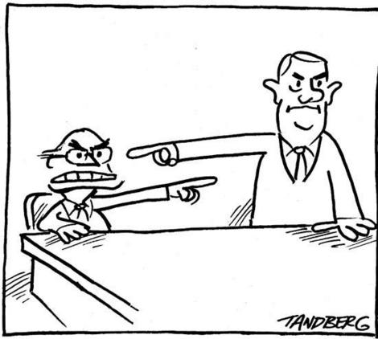
Who has the problem?
The subjective factor
  Client
  Parent
  Professional
Who wins? Who loses?
http://www.randomcrates.com

Slide 5

What is our goal?
Prevention, first of all, but…
it is impossible without understanding the causes of the behaviour
Who decides?
  The client and the parents are our partners
http://silvieandmaryl.com

Slide 6
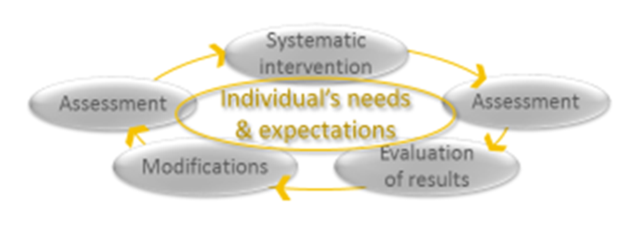
Individualised evidence-based practice
clinical expertise
client’s expectations
PRACTICE
Fits to scientific facts about the nature of condition
Confirmed efficacy: better outcome

Slide 7

Searching for causes
1. Define precisely the behavior
https://www.youtube.com/watch?v=y6liIQfbQ4s
https://www.youtube.com/watch?v=JsJ154jWRsU
2. Assessment:
careful observations (~ 2 weeks) and structured discussions with parents and key workers
3. Developing hypotheses
4. Systematic testing (intervention)
5. Evaluation
An excellent example: the S.T.A.R. Model

Slide 8

S.T.A.R. MODEL (Zarkowska és Clements, 1994; NAS HAS, 2014)
Settings – Körülmények
Triggers – Kiváltók
Actions – Cselekedetek
Results – Eredmények

Slide 9
Settings
life events (e.g. loss, change, trauma, abuse);
current social climate (e.g. deprivation of relationships, conflict and hostility, lack of control, unnecessarily strict control);
current activities/occupational climate (e.g. level and type of stimulation, access to desired activities);
current physical climate (e.g. noise level, temperature, levels of lighting).
Internal and personal influences
  E.g. anxiety states; sadness and depression; communication problems; pain; tiredness and poor physical health; disordered thinking; a lack of social understanding; an inability to occupy self…

Slide 10
S.T.A.R. MODEL (Zarkowska és Clements, 1994, NAS HAS, 2014)
Settings (external & internal)
Triggers (particular signals which set off specific actions)
Actions (frequency, intensity, length of time)
Results (the results the challenging behaviour appears to achieve)

Slide 11
STAR observation & analysis of behaviour

Slide 13
Small group practice

Slide 14

Common causes
Distress and/or anxiety because…
  No experience of controlling others
  High expectations
  Too much control, no independence
  Low expectations
  Understandable/unexpected expectations
Low level of organising unstructured time
Less understanding of consequences
Low impulse-control (executive dysfunctions)
No alternatives (e.g. in communication)
Pain/illness
Comorbid psychiatric disorders
Positive or negative excitement
…
Notes:
ce

Slide 15
Be individualised!
There could be different behaviours with same background
There could be same behaviours with completely different background

Slide 16
Fundamental elements of behaviour management
High ethical standards
Instructional control
  Most effective: communicate what s/he can do,
  Not effective: „Don’t do…”
Communicate expectations on clear, individualised, understandable way
Use individualised motivation (POSITIVE reinforcement),
  but never punishment (!)
Teaching new skills/behaviours/strategies in calm, one-to-one situation
Use comprehensive approach
Evaluate your results

Slide 17
From behaviour to understanding
Age
Mental age (level of intelligence)
Level of language
Level of understanding consequences
behavioural cognitive

Slide 18
Reactive strategies
listen and reflect what is being communicated.
diversion
proximity control
introduce humour
stimulus change do or introduce something unexpected to break the behaviour cycle
sanctions (only if they are non aversive)
physical interventions (ONLY in some occasions where safe and rapid control of a situation is necessary)

Slide 19
Preventive strategies
Ecological manipulations
  Settings, interactions, methods of teaching, noise, clutter etc.
Positive programming
  teaching of skills, development, functional equivalent skills, functionally related skills, coping, rehearsal, tolerance. Social skills training, communication training, clear rules
Direct treatment
  reinforcement schedules, stimulus control, stimulus satiation etc.

Slide 20
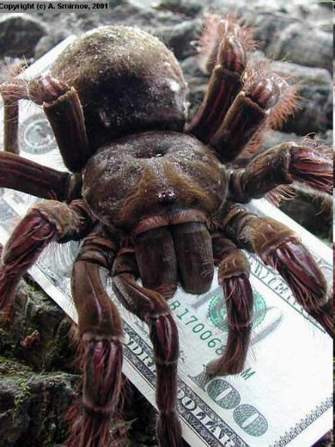


Intervetional techniques
Teaching alternative behaviour(s)
Operant behaviour modification (rewards; chainging, shaping etc.)
Modelling
Ignoring (BE CAREFUL)
Deflection, distraction, offering an alternative
Desensitisation, stimulus satiation
Teaching calming and relaxation techniques
Modification of the environment
Prompting (BE CAREFUL)
Teaching cognitive strategies

Slide 21
These sanctions are NOT permissible
Punishment in general & punishment of the whole group for the activities of individuals
Shouting at a child.
Humiliating, hurting or scaring a child
Corporal punishment is not permitted under any circumstances.
Fears or obsessions CANNOT be used in an aversive manner.
Denial of food or drink.
Force feeding
Washing of soiled clothing or any activity that degrades the child
Wearing of dirty clothing
Seclusion, locking of doors, environmental restraint and withdrawal.
Unproductive sanctions such as writing lines.
Educational activities used as a sanction e.g. writing an essay, additional domestic chores etc.
Preventing access to the telephone or complaints procedure

Slide 22
Small group practice 2
Choose a number from 1 to 13…

Slide 23
Low level of organising unstructured time
Less understanding of consequences
No alternatives (e.g. communication)
High expectations
Too much control, no independence
Distress and/or anxiety because…
No experience of controlling others
Positive or negative excitement
Low expectations
Understandable/unexpected expectations
Low impulse-control (executive dysfunctions)
Pain/illness
Comorbid psychiatric disorders
Please, collect appropriate techniques to prevent challenging behaviours caused by the chosen problem!

Slide 24

Do not think about an intentionally „bad” child/adult…
There is no hopeless case…

Slide 25
Thank you for your attention!
krisztina.stefanik@elte.barczi.hu

